Slide 1
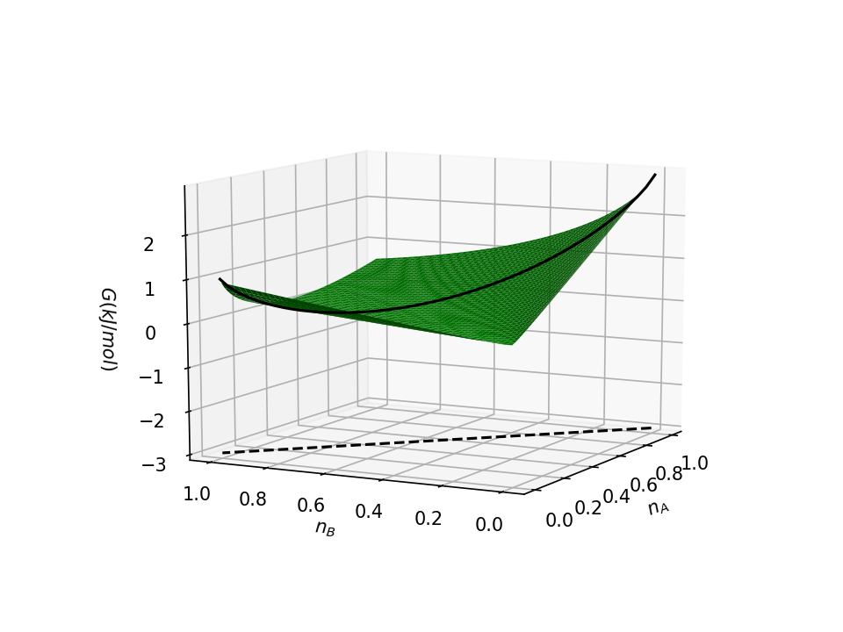
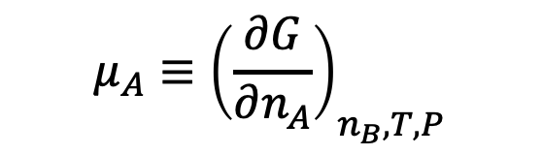
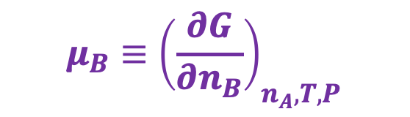
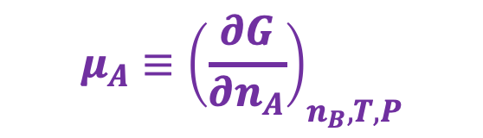
Chemical potentials – they’re just slopes in the $n_{A}$, $n_{B}$ state space
$$μ_{A}≡{\left(\frac{∂G}{∂n_{A}}\right)}_{n_{B}, T,P}$$
$$μ_{B}≡{\left(\frac{∂G}{∂n_{B}}\right)}_{n_{A}, T,P}$$
$$μ_{A}≡{\left(\frac{∂G}{∂n_{A}}\right)}_{n_{B}, T,P}$$

Slide 2
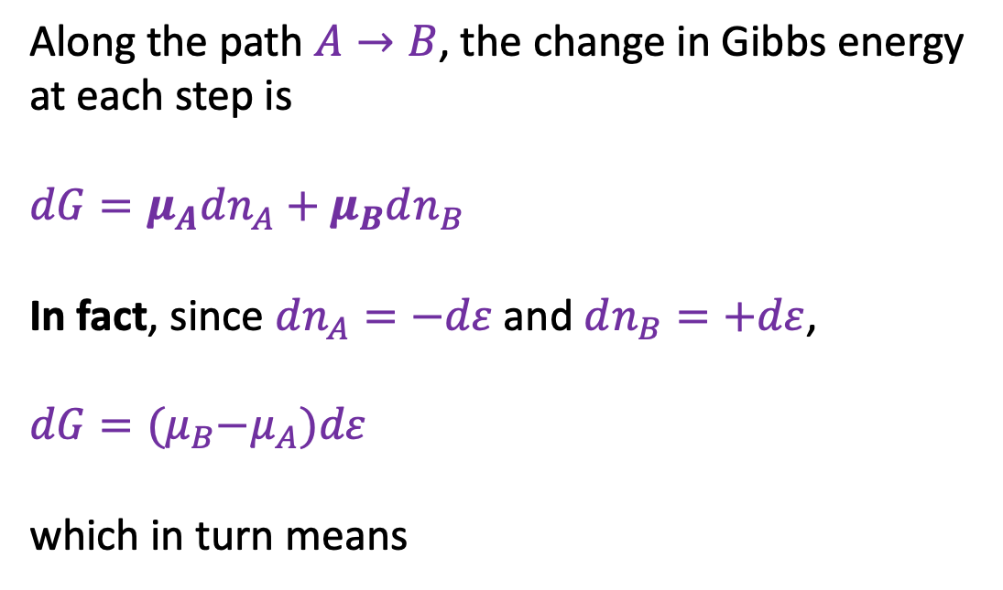


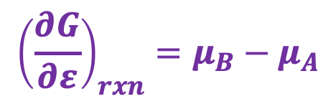
Why we care about chemical potentials
Along the path $A→B$, the change in Gibbs energy at each step is
$$dG=μ_{A}dn_{A}+μ_{B}dn_{B}$$
In fact, since $dn_{A}=−dε$ and $dn_{B}=+dε$,
$$dG={(μ}_{B}−μ_{A})dε$$
which in turn means
$$dn_{B}$$
$${\left(\frac{∂G}{∂ε}\right)}_{rxn}=μ_{B}−μ_{A}$$
$$dn_{A}$$

Slide 3
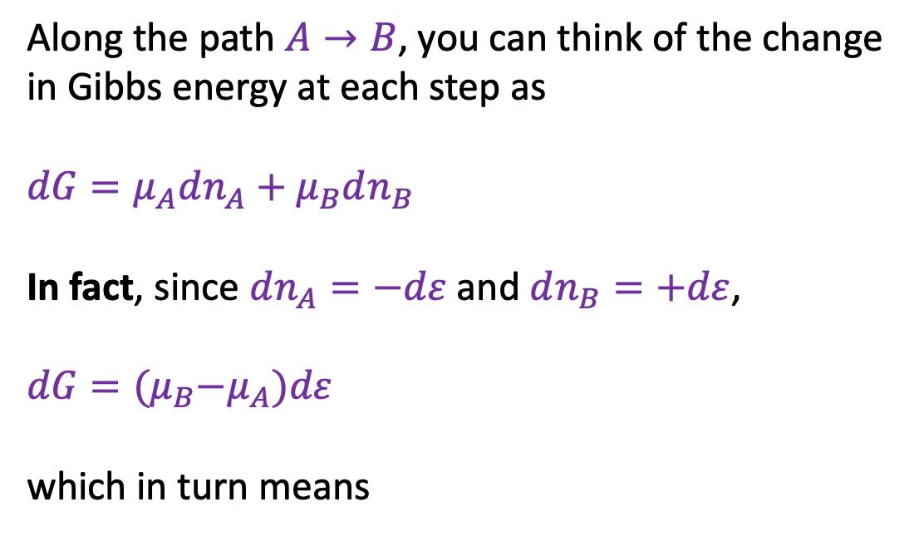
Why we care about chemical potentials
Along the path $A→B$, you can think of the change in Gibbs energy at each step as
$$dG=μ_{A}dn_{A}+μ_{B}dn_{B}$$
In fact, since $dn_{A}=−dε$ and $dn_{B}=+dε$,
$$dG={(μ}_{B}−μ_{A})dε$$
which in turn means
$$dn_{B}$$
$${\left(\frac{∂G}{∂ε}\right)}_{rxn}=μ_{B}−μ_{A}$$
$$dn_{A}$$
What does it mean? The difference in chemical potential of products and reactants drives the reaction forward or backward. When chemical potentials are the same, we’re at equilibrium.

Slide 4
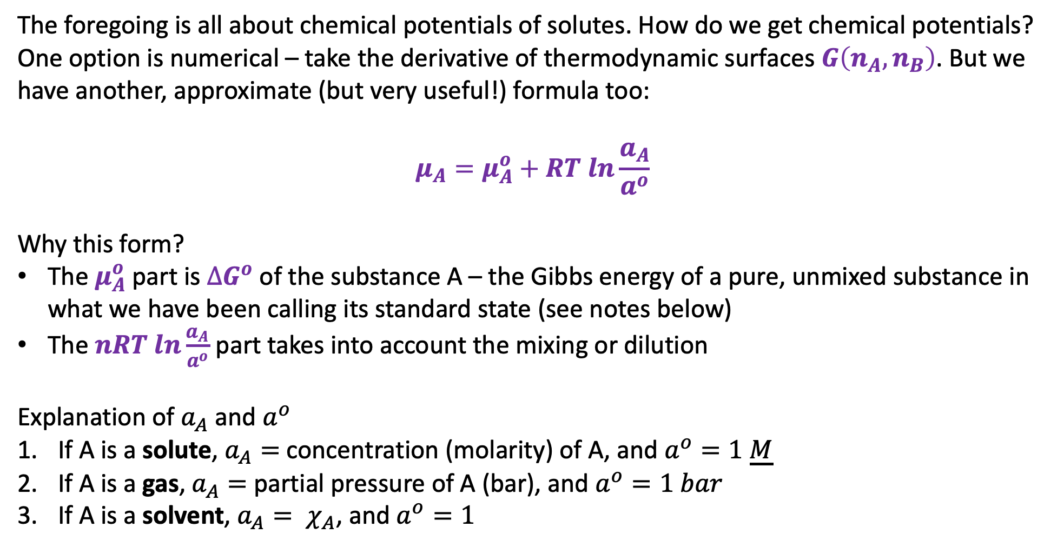
A generalization of chemical potentials
The foregoing is all about chemical potentials of solutes. How do we get chemical potentials? One option is numerical – take the derivative of thermodynamic surfaces $G\left(n_{A},n_{B}\right)$. But we have another, approximate (but very useful!) formula too:
$$μ_{A}=μ_{A}^{o}+RT ln\frac{a_{A}}{a^{o}}$$
Why this form?
The $μ_{A}^{o}$ part is $∆G^{o}$ of the substance A – the Gibbs energy of a pure, unmixed substance in what we have been calling its standard state (see notes below)
The $nRT ln\frac{a_{A}}{a^{o}}$ part takes into account the mixing or dilution
Explanation of $a_{A}$ and $a^{o}$
If A is a solute, $a_{A}=$ concentration (molarity) of A, and $a^{o}=1 \underline{M}$
If A is a gas, $a_{A}=$ partial pressure of A (bar), and $a^{o}=1 bar$
If A is a solvent, $a_{A}= χ_{A}$, and $a^{o}=1$

Slide 5

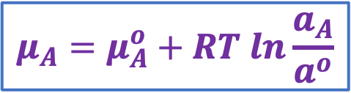

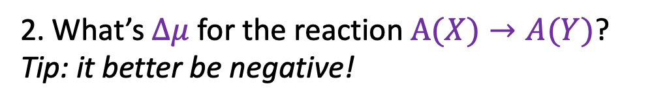


Example #1: Solutes
Solute A in chamber Y is 1/3 its concentration in chamber X.
$$μ_{A}\left(X\right)$$
$$μ_{A}\left(Y\right)$$
1. Which is correct?
$$μ_{A}\left(Y\right)$$
$$μ_{A}\left(X\right)$$
2. What’s $∆μ$ for the reaction $A(X)→A(Y)$?
Tip: it better be negative!
$$μ_{A}=μ_{A}^{o}+RT ln\frac{a_{A}}{a^{o}}$$
X
Y
A(aq)
A(aq)
A(aq)
A(aq)

Slide 6
Example #1: Solutes
Solute A in chamber Y is 1/3 its concentration in chamber X.
$$μ_{A}\left(X\right)$$
$$μ_{A}\left(Y\right)$$
1. Which is correct?
$$μ_{A}\left(Y\right)$$
$$μ_{A}\left(X\right)$$
2. What’s $∆μ$ for the reaction $A(X)→A(Y)$?
Tip: it better be negative!
$$μ_{A}=μ_{A}^{o}+RT ln\frac{a_{A}}{a^{o}}$$
X
Y
A(aq)
A(aq)
A(aq)
A(aq)

Slide 7


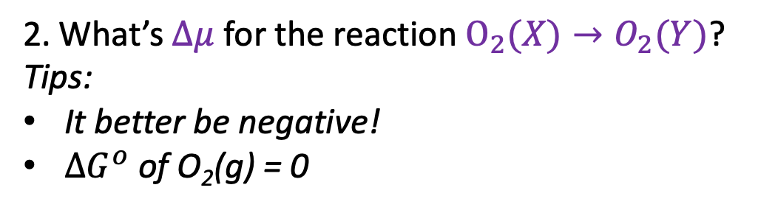


Example #2: Gases
O₂(g) makes up 21% of Earth’s atmosphere
$$μ_{O_{2}}\left(X\right)$$
$$μ_{O_{2}}\left(Y\right)$$
1. Which is correct?
$$μ_{O_{2}}\left(Y\right)$$
$$μ_{O_{2}}\left(X\right)$$
2. What’s $∆μ$ for the reaction $O_{2}(X)→O_{2}(Y)$?
Tips:
It better be negative!
$∆G^{o}$ of O₂(g) = 0
$$μ_{A}=μ_{A}^{o}+RT ln\frac{a_{A}}{a^{o}}$$
X
Y
Pure O₂(g)
1 atm
Air
21% O₂(g)

Slide 8


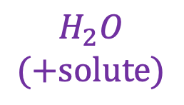


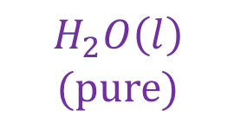
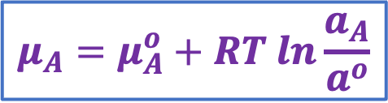
Example #3: Solvents
Chamber X is a 1 M solution of NaCl(aq). Chamber Y is pure water.
1. Which is correct?
X
Y
$$μ_{H_{2}O}\left(X\right)$$
$$μ_{H_{2}O}\left(Y\right)$$
$$H_{2}O$$
$$(+solute)$$
$$H_{2}O\left(l\right)$$
$$(pure)$$
$$μ_{H_{2}O}\left(Y\right)$$
$$μ_{H_{2}O}\left(X\right)$$
$$μ_{A}=μ_{A}^{o}+RT ln\frac{a_{A}}{a^{o}}$$

Slide 9
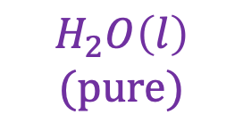
Example #3: Solvents
Chamber X is a 1 M solution of NaCl(aq). Chamber Y is pure water.
1. Which is correct?
X
Y
$$μ_{H_{2}O}\left(X\right)$$
$$μ_{H_{2}O}\left(Y\right)$$
$$H_{2}O$$
$$(+solute)$$
$$H_{2}O\left(l\right)$$
$$(pure)$$
$$μ_{H_{2}O}\left(Y\right)$$
$$μ_{H_{2}O}\left(X\right)$$
$$μ_{A}=μ_{A}^{o}+RT ln\frac{a_{A}}{a^{o}}$$
Tip: Water spontaneously moves from the pure side to the side with solute!

Slide 10
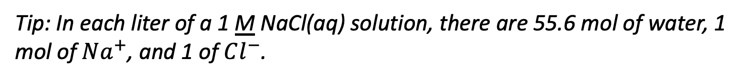
Example #3: Solvents
Chamber X is a 1 M solution of NaCl(aq). Chamber Y is pure water.
1. Which is correct?
X
Y
$$μ_{H_{2}O}\left(X\right)$$
$$μ_{H_{2}O}\left(Y\right)$$
$$H_{2}O$$
$$(+solute)$$
$$H_{2}O\left(l\right)$$
$$(pure)$$
$$μ_{H_{2}O}\left(Y\right)$$
$$μ_{H_{2}O}\left(X\right)$$
$$μ_{A}=μ_{A}^{o}+RT ln\frac{a_{A}}{a^{o}}$$
2. What’s $∆μ$ for the reaction $H_{2}O(X)→H_{2}O(Y)$?
Tip: In each liter of a 1 M NaCl(aq) solution, there are 55.6 mol of water, 1 mol of $Na^{+}$, and 1 of $Cl^{−}$.

Slide 11
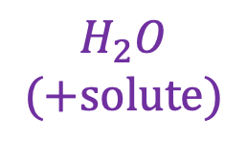
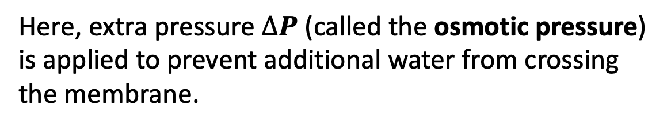


Example #4: Osmotic pressure
Here, extra pressure $∆P$ (called the osmotic pressure) is applied to prevent additional water from crossing the membrane.
X
Y
$$∆P$$
$$H_{2}O$$
$$(+solute)$$
$$H_{2}O\left(l\right)$$
$$(pure)$$

Slide 12
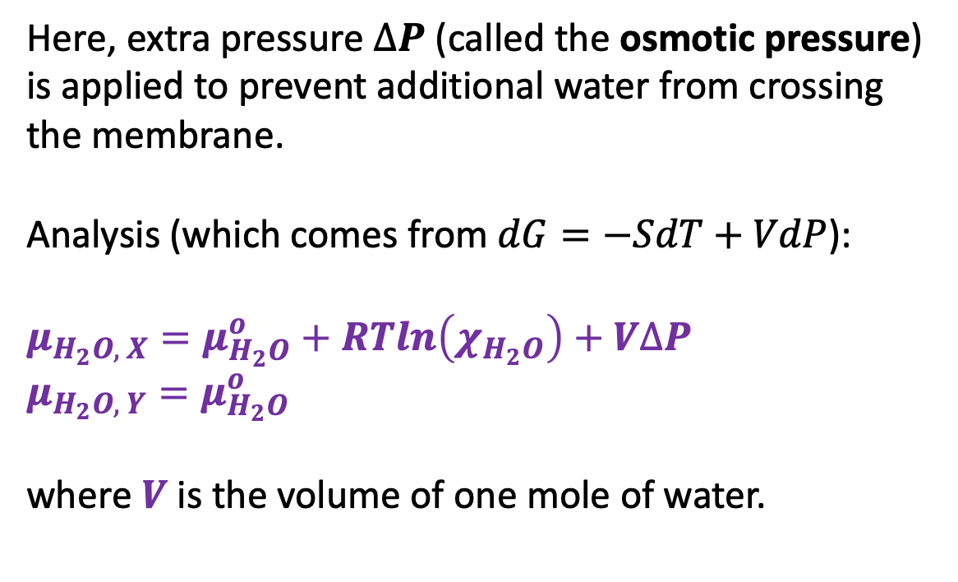
Example #4: Osmotic pressure
Here, extra pressure $∆P$ (called the osmotic pressure) is applied to prevent additional water from crossing the membrane.
Analysis (which comes from $dG=−SdT+VdP$):
$μ_{H_{2}O, X}=μ_{H_{2}O}^{o}+RTln\left(χ_{H_{2}O}\right)+V∆P$
$μ_{H_{2}O, Y}=μ_{H_{2}O}^{o}$
where $V$ is the volume of one mole of water.
X
Y
$$∆P$$
$$H_{2}O$$
$$(+solute)$$
$$H_{2}O\left(l\right)$$
$$(pure)$$

Slide 13
Example #4: Osmotic pressure
Here, extra pressure $∆P$ (called the osmotic pressure) is applied to prevent additional water from crossing the membrane.
Analysis (which comes from $dG=−SdT+VdP$):
$μ_{H_{2}O, X}=μ_{H_{2}O}^{o}+RTln\left(χ_{H_{2}O}\right)+V∆P$
$μ_{H_{2}O, Y}=μ_{H_{2}O}^{o}$
where $V$ is the volume of one mole of water.
X
Y
$$∆P$$
$$H_{2}O$$
$$(+solute)$$
$$H_{2}O\left(l\right)$$
$$(pure)$$
What’s the osmotic pressure when the solute-containing chamber contains 1 M NaCl(aq)?

